Slide 1
Java SE 8 Book Presentation
Chapter 3 – Java Basic

Slide 2
3.3 – Components of a Java program
The source code: All of the source code for a Java Program is contained within a “type definition” (the word “type” is much more accurate since there are many definition types such as “Classes”, “Interface” or “Enum”) and these definitions are contained within one or multiple files with an extension “.java”
Java APIs (Java Standard library classes): As mention, Java has a huge library called Java APIs and any Java program could refer to one of these ready-to-use classes. As most of these classes are compiled => we don’t need to copy and paste their code into our program file and re-compile it, we just need to import it (we will talk about “import” key word later)
3rd Party libraries: A Java program could contain Java APIs or 3rd party libraries => their source code are packed into some file with “.jar” extension => the source code may not be available => to use these libraries, we have to put the “.jar” file into something called “Classpath” (“Classpath” is a environment variable for JVM to lookup a specific classes, usually this is used to import classes from libraries that is outside Java APIs)

Slide 3
3.3 – Components of a Java program: 3.3.1 – Structure of a Java Class
A Java program primarily contains 3 things:
Zero or one package statement
Zero or more import statements
One or more “type” definitions

Slide 4
3.4 – Compiling and running a basic Java Program
A special method called “main” has been created, which marks the start of a Java program => if the “main” method doesn’t creates new variables, objects or calling object methods => the “main” method mostly called Java Program. However, since Java is Object-oriented, we can’t create a method without creating a new “class” since method is the same as “an action of an object” and this “action” could only be catched and expressed through “class” => even a simple program just print “Hello world”, we still need a class (demonstrate file)

Slide 5
3.5 – Understanding the “MAIN” method: 3.5.1 – The main method
Running Java program is not the same as running Windows apps (“.exe” file). When we run a Java program, it produces a “.class” file, which is the input for JVM to execute the program => JVM here is the executable (the “.exe” file). However, Java class file and JVM cannot be run using the same method in Windows => we have to pass the Java class name that we want to run as an Argument to JVM
When JVM runs, it starts to find a special method in that class. When it found the method, it passes the control to that method (which mean everything contained inside that method will be executed from the method and the JVM job is just interprete whatever inside that method). If JVM doesn’t find that method => it gives out error
That method is called “main” method (is “static”, required “String array” argument, is “public”, the name must be “main”)
(! NOTE: Java is case sensitive => if the method name is “Main” => Error since the correct name of the method is “main”)
- However, all of the incorrect examples shown are still correct to some extent because most of them are valid Java method (some of them are example of something called “Overloaded Method”). But, all of them cannot be accepted as “main” and if you try to execute the class with the incorrect “main” method => JVM will complain and throw error

Slide 6

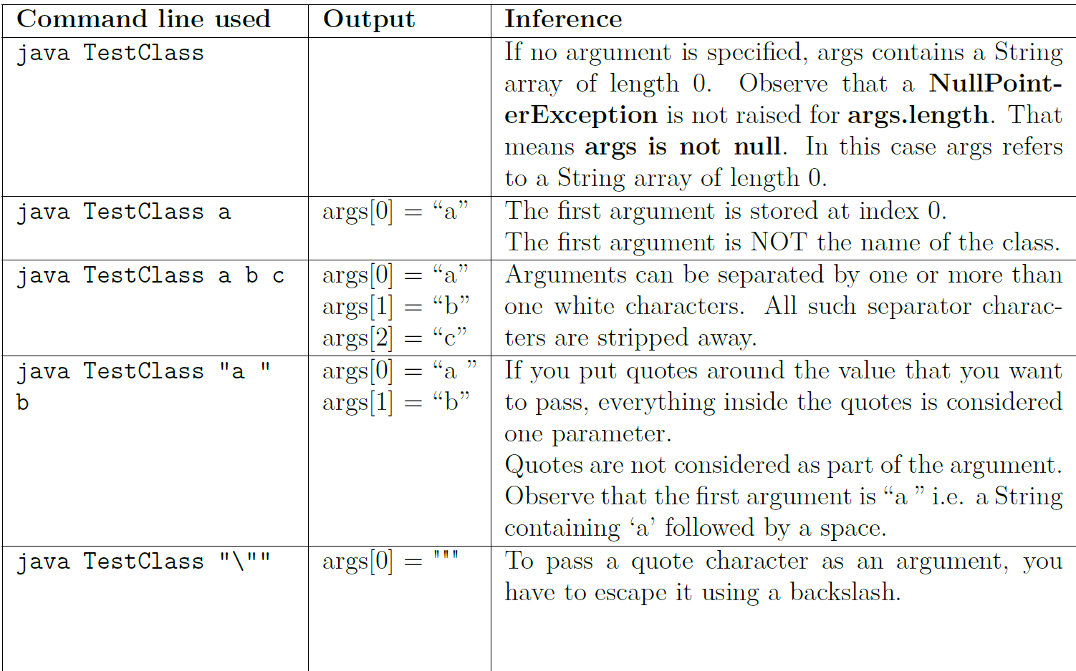
3.5 – Understanding the “MAIN” method: 3.5.2 – Command Line Argument
It is possible to pass any number of arguments while executing a class by specifying each of the arguments right after the execution command in the command line (Demonstrate code and explain)

Slide 7
3.5 – Understanding the “MAIN” method: 3.5.3 – The end of “main” function
JVM understands that the Java program is run when the “main” method is called => However, the end of “main” method doesn’t indicate the end of an entire program (it depends on what is inside of “main” method)
If the Java program is simple with just some printing things and looping things => the end of “main” method is the end of the entire program since there are nothing else to do
However, Java program is a combination of many classes interact with each other => the “main” method is where each object of each class is created and their method would be called and interact further => the “main” method could reach to the end, but, the program doesn’t since the interaction between the objects created from “main” hasn’ stopped yet
E.g: Java FileIO APIs (file opening and closing even after the “main” method has reached the end” )

Slide 8
3.6 Object-Oriented Programming – “APIE”
Abstraction: Abstraction is capturing relevant details of an entity or a concept => Once a concept is defined, many instances could be created
Polymorphism: Polymorphism means same entity exhibiting different behavior (this is actually direct consequence of inheritance)
Inheritance: Inheritance is process of creating specialized entities by extending existing entities (in other word, inheritance is creating “paternity” between existing and newer objects), this allows new objects or features to be added quickly by reusing the existing attributes and methods of an existing object.
Encapsulation: Encapsulation is about protecting the properties and the functionality of an object

Slide 9
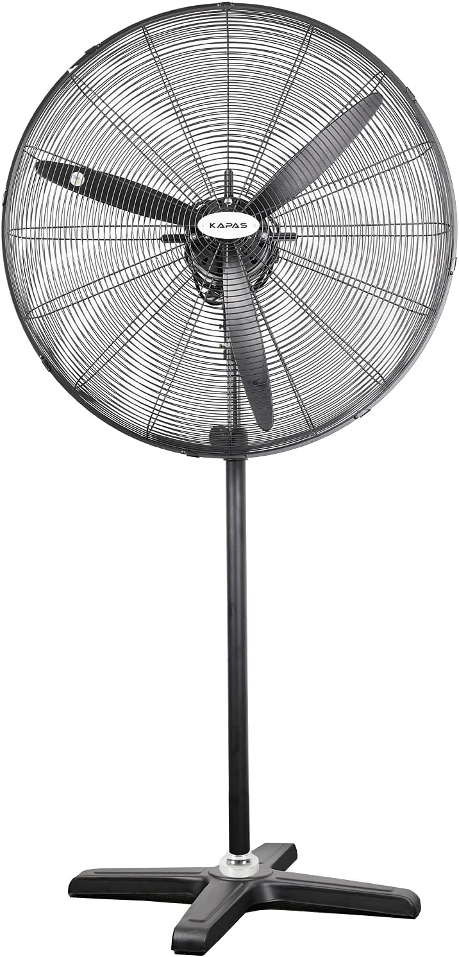
3.6 Object-Oriented Programming: 3.6.4 – OOP in Java
Class: Class is a building block to describe details of an object
Describing Object
(Illustrating the code and use the Food – Shop example)
II) Describing Behaviour
Let’s take a fan for example, fan can be turned on – off using “switch”, we just need to simply push the switch on or off and what happen after the push depends on the device.
What we have just identified is the “Behavioral aspect of things”. When we say something is switched on or off => we have described its behavior (a fan, a light bulb, a car are also the same)
Once we have identified all of that behaviours, we can treat them in the same way using something called “interface”
- “Interface” advantage: easier for maintenance

Slide 10
3.6 Object-Oriented Programming: 3.6.4 – OOP in Java
III) Creating object (illustrating the code)
IV) Making objects interact
Interact by “reference”
V) Launching a Java program (illustrating the code)
“main” => object interact

Slide 11
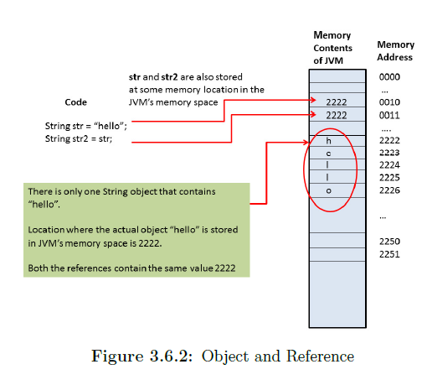
3.6 Object-Oriented Programming: 3.6.5 – Relationship between Class, Object and Reference
Class = template for objects (blueprint)
Reference = address to that specific object
Reference variable IS NOT THE SAME as primitive variable (byte array in RAM, how string represented in RAM)
Only reference can contain “null”, primitive cant since JVM knows…

Slide 12
3.6 Object-Oriented Programming: 3.6.6 – Static and instance
“Static” = constant + belong to class = same for all objects
Belong to all objects => no need to create objs
“Static” is not OOP features

